Slide 1
Contemporary Moral Problems
Today’s Agenda
Clicker Quiz on Thomson & Hursthouse
Finish Thomson, Begin Hursthouse
Describe what philosophical skills and understanding of ethical theory you lacked before the course, and how you honed those skills and your understanding throughout the quarter.

Slide 2
Contemporary Moral Problems
M-F12:00-1:00SAV 264
Instructor: Benjamin Hole
Email: bvhole@uw.edu
Office Hours: everyday after class

Slide 3

Agenda
Clicker Quiz
Finish Thomson
HURSTHOUSE

Slide 4

QUIZ
Please set your Turning Technology Clicker to channel 41
Press “Ch”, then “41”, then “Ch”

Slide 5
What attitude does Thomson take toward the claim that a fetus is a person (with the right to life) from the moment of conception?
she believes it is true, and uses it as an assumption.
she believes it is true, but asks what would follow if it were false.
she believes it is false, and ignores it.
she believes it is false, but asks what would follow if it were true.
none of the above.

Slide 6
The case of the violinist is meant to show that:
abortion is always morally permissible.
it is not the case that all persons have a right to life.
the right to life does not entail the right not to be killed.
everyone has a positive right to the bare minimum needed to keep them alive.
none of the above.

Slide 7
Thomson claims that if the violinist only needed to be hooked up to your kidneys for an hour:
it would be unjust to unhook yourself from him.
to unhook yourself from him would violate his right to life.
you would be a “Good Samaritan” if you did not unhook yourself from him.
all of the above.

Slide 8
Thomson concludes that abortion is morally permissible:
only in cases of self-defense.
only in cases of rape, or where the health of the mother is threatened.
in many but not all cases.
in all cases.
none of the above.

Slide 9
According to Hursthouse, virtue ethics provides an answer to the question:
What should I do?
What sort of person should I be?
both a and b.
neither a nor b.

Slide 10
Rosalind Hursthouse
“Virtue Ethics and Abortion”

Slide 11

A Different Starting Point for Ethics
Most moral theories: What is the right thing to do?
Virtue ethics: What kind of person should I be? How should I live my life?
Virtue ethics is a family of theories that traces its roots (in the West) back to the ancient Greek philosopher Aristotle.
The aim of these theories is to discover the conditions and character traits that contribute to human flourishing.

Slide 12
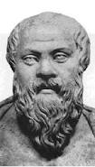
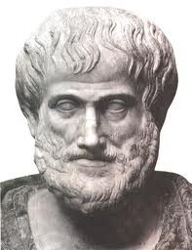


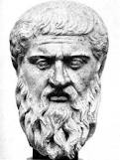
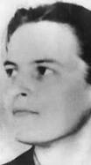
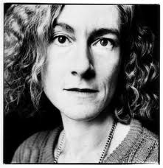
Virtue Ethics, A brief History

Slide 13
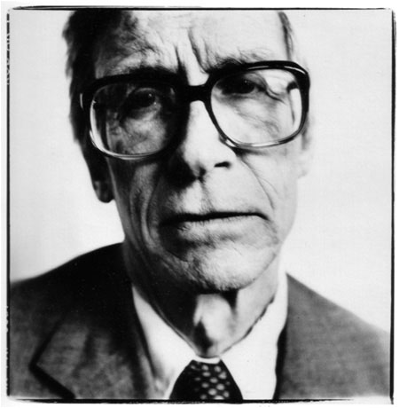
The Primacy of Character
The term ‘Aristotelian virtue ethics’ describes a class of theories; the aim of these theories is to discover the conditions and character traits that contribute to eudaimonia.
Eudaimonia often translated as ‘happiness’ or ‘human flourishing’

Slide 14
The Primacy of Character
Right Action Bi-Conditional
An act is morally right if and only if (and because) it is the one that a virtuous person, acting in character, would do in that situation.
The term ‘Aristotelian virtue ethics’ describes a class of theories; the aim of these theories is to discover the conditions and character traits that contribute to eudaimonia.
Eudaimonia often translated as ‘happiness’ or ‘human flourishing’

Slide 15
Rosalind Hursthouse: “Virtue Theory and Abortion”
The Pope’s Argument
Hursthouse
A fetus is a person with the right to life.
It is morally wrong to kill a person with the right to life.
Therefore, it is morally wrong to kill a fetus. (Abortion is immoral.)
Argues that although the debate about abortion has tended to be focused on two considerations —the moral status of the fetus and the rights of the mother— a virtue oriented approach regards these two considerations as largely irrelevant to the issue.

Slide 16
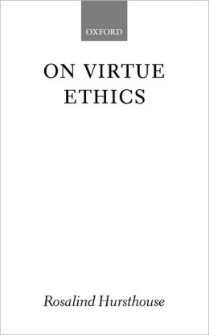
A sketch of a virtue-oriented theory
An action is right if and only if it is what a virtuous agent would do in the circumstances.
A virtuous agent is one who acts virtuously; that is, one who has and exercises all the virtues.
A virtue is a character trait a human being needs to flourish or live well.
Hursthouse: We must go on to specify which traits count as virtues and argue for this.
Notes:
16

Slide 17
Objections & Responses
Some initial clarifications
Eudaimonia is a difficult concept, but not substantially more so than rationality or happiness.
Virtue ethics is not trivially circular.
Virtue ethics answers the questions “What should I do?” as well as “What kind of person should I be?”
Virtue ethics does involve rules or principles.
Virtue theory is not committed to reductionism.
Notes:
17

Slide 18
Forges a link between right action and moral rule.
Deontology
P1 An action is right if it is in accordance with a moral rule or principle.
P2 A moral rule is one that…
Forges a link between moral rule and rationality.
…is laid on us by God; or
…is required by natural law; or
…is laid on us by reason; or
…is required by rationality; or
…would command universal rational acceptance; or
…would be the object of choice of all rational beings.

Slide 19
Utilitarianism
Forges a link between right action and consequences.
P1 An action is right if it promotes the best consequences.
P2 The best consequences are those in which happiness is maximized.
Desire Satisfaction Theory
Hedonism
Perfectionism (Objective List Theory)
Forges a link between consequences and happiness.

Slide 20
Virtue Theory
Forges a link between right action and the virtuous agent.
P1 An action is right if it is what a virtuous agent would do in the circumstances.
P1a A virtuous agent is one who acts virtuously, that is, one who has an exercises the virtues.
P2 A virtue is a character train a human being needs to flourish or live well.
Forges a link between virtue and flourishing/ living well/ eudaimonia.

Slide 21
Eudaimonia is a difficult concept, but not substantially more so than rationality or happiness.
Strongly Agree
Agree
Somewhat Agree
Neutral
Somewhat Disagree
Disagree
Strongly Disagree

Slide 22
Objections & Responses
Some initial clarifications
Eudaimonia is a difficult concept, but not substantially more so than rationality or happiness.
Virtue ethics is not trivially circular.
Virtue ethics answers the questions “What should I do?” as well as “What kind of person should I be?”
Virtue ethics does involve rules or principles.
Virtue theory is not committed to reductionism.
Notes:
22

Slide 23
Circularity and Action Guidance
Virtue theory avoids the complaint of circularity by specifying right action in terms of the virtuous agent, she in terms of virtues, and these as characteristics required for eudaimonia.
As such, virtue theory is concerned both with “What should I do?” and “What kind of person should I be?”
Every virtue generates a positive instruction, and every vice a prohibition.
The agent may skip emulating some virtuous agent, and instead ask herself, “If I were to do such-and-such now, would I be action justly or unjustly, kindly or unkindly… etc.”

Slide 24
Virtue ethics is not trivially circular.
Strongly Agree
Agree
Somewhat Agree
Neutral
Somewhat Disagree
Disagree
Strongly Disagree

Slide 25
Virtue ethics answers the questions “What should I do?” as well as “What kind of person should I be?”
Strongly Agree
Agree
Somewhat Agree
Neutral
Somewhat Disagree
Disagree
Strongly Disagree

Slide 26
Virtue ethics does involve rules or principles.
Strongly Agree
Agree
Somewhat Agree
Neutral
Somewhat Disagree
Disagree
Strongly Disagree

Slide 27
Reductionism?
John Rawls: “The two main concepts of ethics are those of the right and the good; the concept of a morally worthy person is, I believe, derived from them.” (TofJ, Rawls, 24)
The RIGHT
The GOOD
(Virtuous Character?)

Slide 28
Virtue theory is not committed to reductionism.
Strongly Agree
Agree
Somewhat Agree
Neutral
Somewhat Disagree
Disagree
Strongly Disagree

Slide 29
Objections & Responses
Two more objections to virtue ethics
Which character traits are virtues is disputed, and subject to the threat of moral skepticism or relativism.
Virtue ethics has unresolvable conflict built into it (as virtues often conflict).
Hursthouse: These are equally problems for rival ethical theories, such as deontology and consequentialism.
Notes:
29

Slide 30
Hursthouse: These objections are equally problems for rival ethical theories, such as deontology and consequentialism.
Strongly Agree
Agree
Somewhat Agree
Neutral
Somewhat Disagree
Disagree
Strongly Disagree

Slide 31
The major criticism of virtue
Objection: Virtue can’t “get us anywhere” because it relies on:
Understanding of virtues and vices.
Evaluative concepts such as the worthwhile.
Hursthouse’s Response
The major criticism places unreasonable constraints on an adequate moral theory.
A discussion of abortion makes clear the ways in which virtue theory can shed light on moral issues.
Notes:
31

Slide 32
Hursthouse: The major criticism places unreasonable constraints on an adequate moral theory.
Strongly Agree
Agree
Somewhat Agree
Neutral
Somewhat Disagree
Disagree
Strongly Disagree

Slide 33
Virtue and Abortion
Hursthouse claims that we should begin by asking how the familiar biological facts of abortion figure in the practical reasoning of a virtuous agent.
Reflection on these facts prompts the realization that pregnancy is not just one among many physical conditions, but a state that is typically attended by strong emotions and attachments.
Does not focus on
Rights of the woman
Moral status of the fetus
Does focus on
Biological facts surrounding abortion
The thoughts and feelings that ought to accompany the circumstances
Notes:
33

Slide 34
Virtue and Abortion
Does not focus on
Rights of the woman
Moral status of the fetus
Does focus on
Biological facts surrounding abortion
The thoughts and feelings that ought to accompany the circumstances
Hursthouse's Conclusion Depending on the circumstances, abortion can be right in some cases but not in others. Even in cases where it is right, guilt and remorse are sometimes called for.
Notes:
34

Slide 35
Hursthouse: Depending on the circumstances, abortion can be right in some cases but not in others.
Strongly Agree
Agree
Somewhat Agree
Neutral
Somewhat Disagree
Disagree
Strongly Disagree

